Slide 1


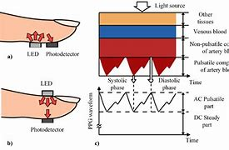
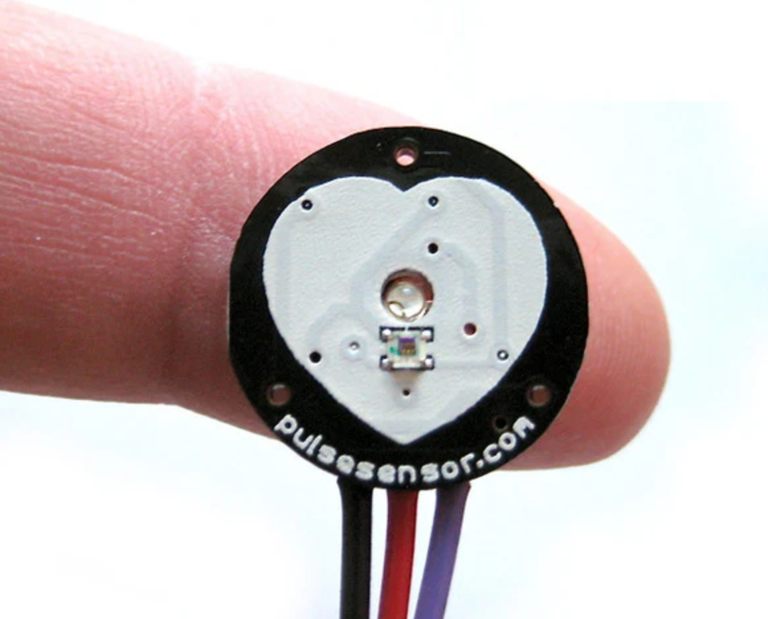
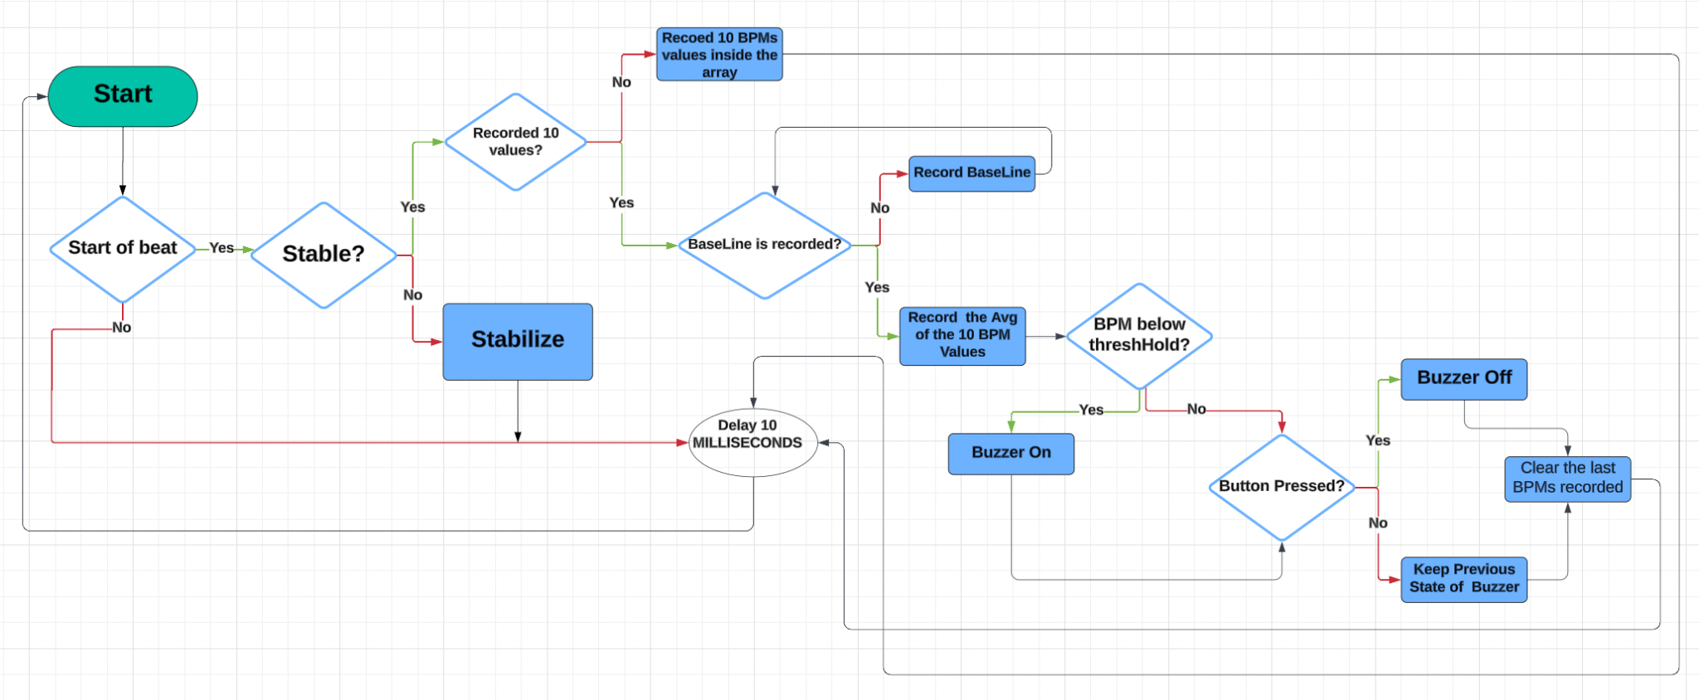
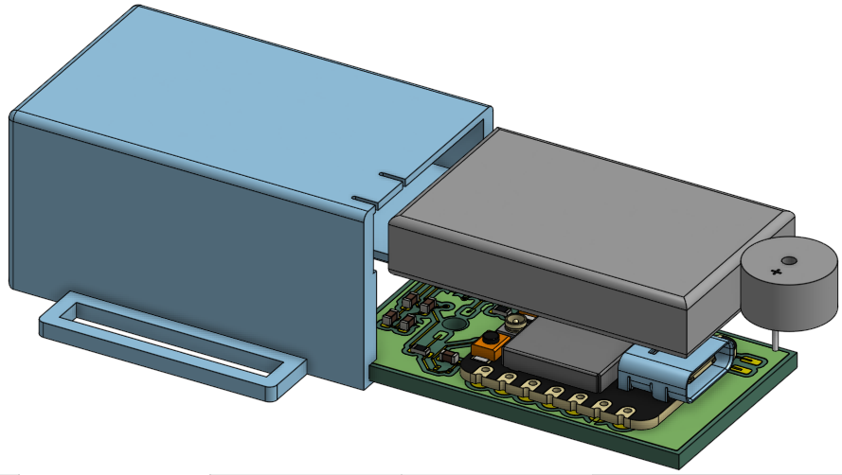

Ayah Aldawsari, Sharida Almutlaq, Cesar Torres Sandoval
Driver’s Safety
ECE 196 - Winter 2023
Problem Definition
Driving while falling asleep is akin to reckless driving or drunk driving and carries similar consequences. People who become drowsy behind the wheel may endanger themselves and others when their sleepiness leads to loss of vehicle control and even unconsciousness.
Solution
In order to alert a driver when they are falling asleep, a wearable device will alert the user when their BPM has dropped below a certain threshold that determines sleepiness. The device must be non-obstructive to avoid driving discomfort, user friendly to provide ease of use and adjustability, and non-disturbing such that alerts do not startle drivers into making dangerous maneuvers.
Testable Hypothesis:
Photoplethysmography
Design:
Signal Capture and Wearability
Prototype:
Pulse Sensor with Arduino
Test Results:
Sleepiness Thresholds & Adjustment
Image Link
https://www.researchgate.net/figure/Principle-of-photoplethysmography-PPG-104-a-reflective-mode-b-transmitting_fig7_338723696
Website QR Code Here

